Slide 1
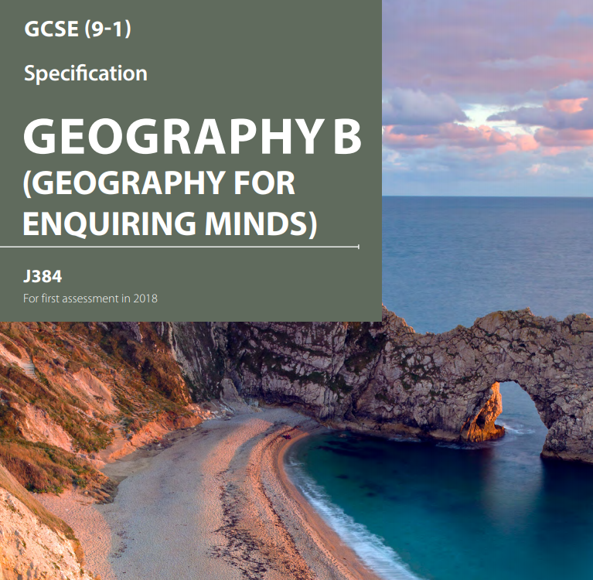

Geography is not only up-to-date and relevant, it is one of the most exciting, adventurous and valuable subjects to study at GCSE.
Geography marries together the world of hard scientific fact and process, with human interaction and reaction, through skilful application.
With the challenges that the world faces today, there are few other subjects that equip students with the range of skills necessary to understand and explore these issues.
It allows students to really appreciate the processes that are going on all around us, and how we can respond to some of the key challenges that our world is currently facing
Why study GCSE geography?

Slide 2

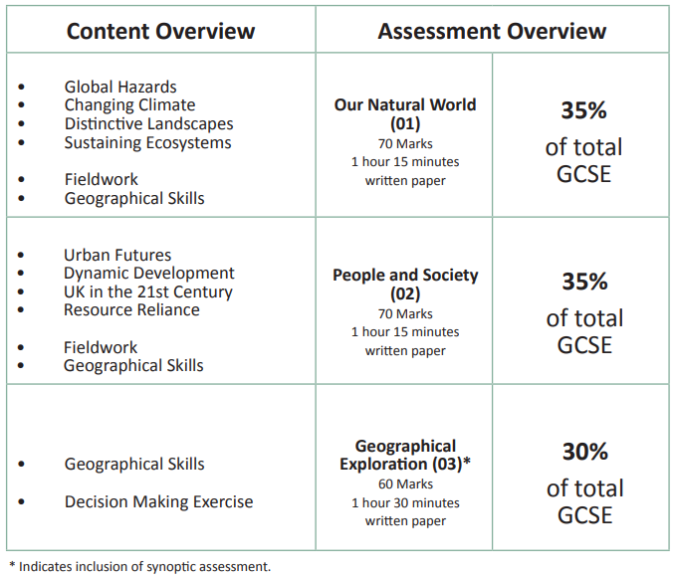

Slide 3
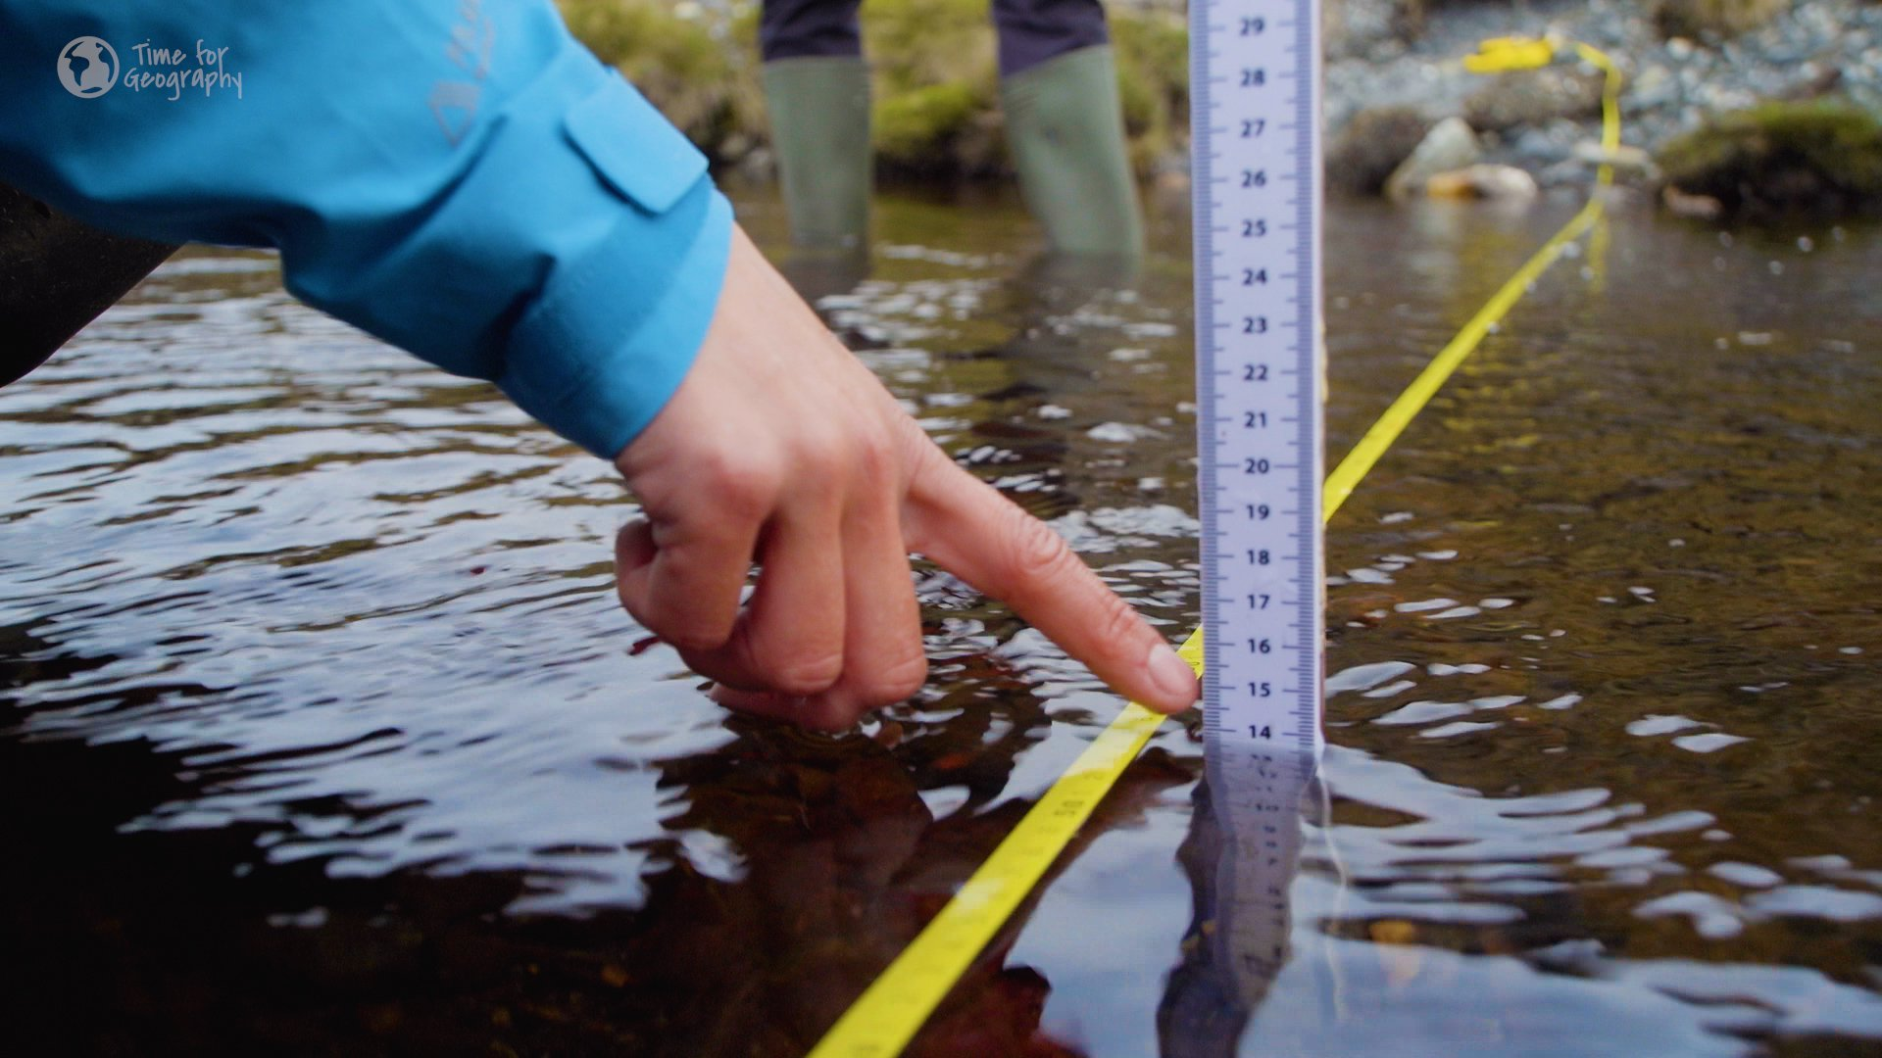
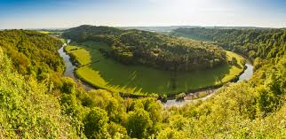
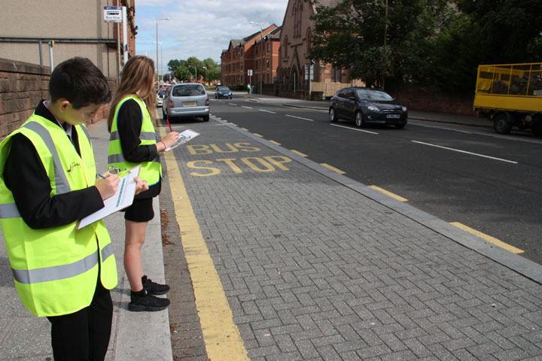

Fieldwork: You will do two pieces of fieldwork. The first is a trip near the River Wye, the second is along London Road. This helps students understand the variety of approaches towards fieldwork in geography, allowing them to get to grips with the techniques that are commonly used. It prepares them for the exam, but also gives them an exciting opportunity to experience learning outside the classroom
Notes:
Porlock bay

Slide 4

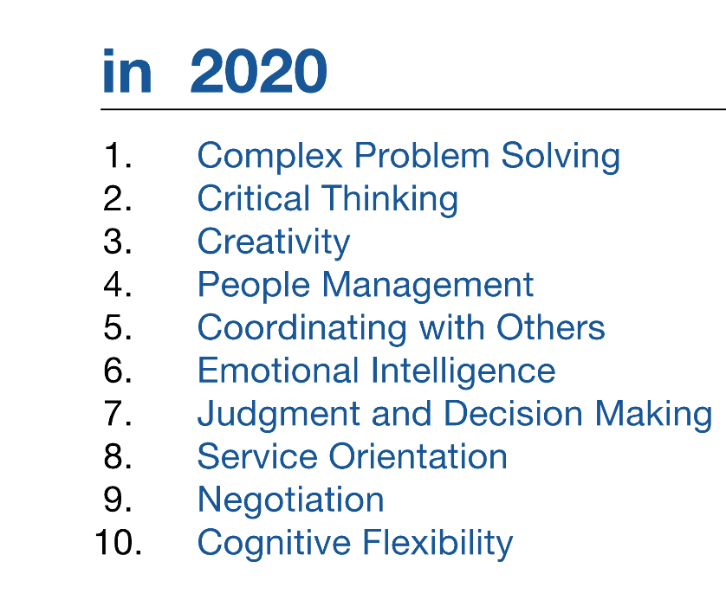

Skills
GCSE Geography addresses all of these, helping to prepare students with the skills they will need in the wider world.
Geography broadens students’ horizons and their opportunities. The subject can lead to careers in a wide range of areas including:
Urban regeneration
Sustainability and climate change
Energy
Hazard mitigation
Law
International Development
Teaching

