Slide 1



BTEC Tech Awards Health and Social Care
For more information
https://qualifications.pearson.com/en/qualifications/btec-tech-awards/health-and-social-care.html

Slide 2
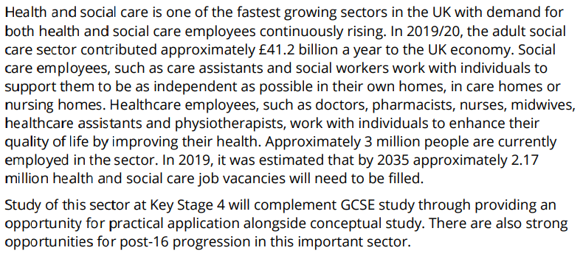
About Health and Social care – from Pearson

Slide 3
How are you assessed?
Component 1 - Human Lifespan Development
  Internally Controlled Assessment (10 hour written assessment) - 30% of final grade
Component 2 - Health and Social Care Services and Values
  Internally Controlled Assessment (10 hour written assessment) - 30% of final grade
Component 3 - Health and Wellbeing
  External Assessment (2 hours) - 40% of final grade.
  Exam entries possible January and June, resit option available.

Slide 4
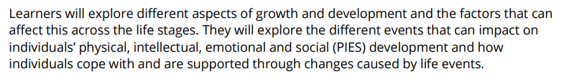
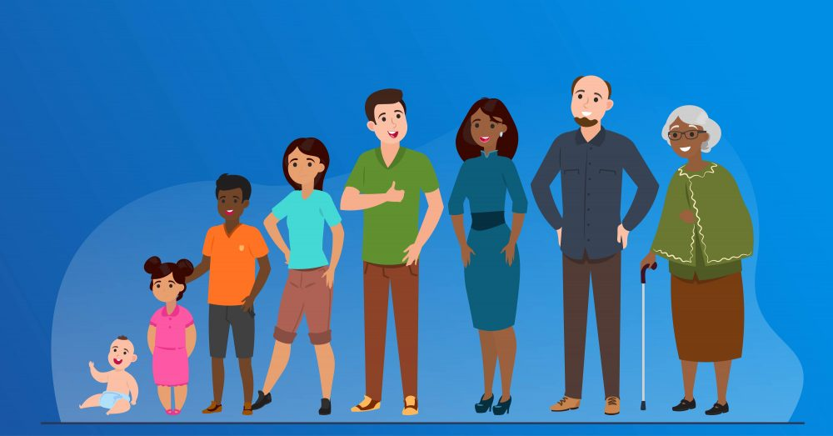
Component 1 – Human lifespan development

Slide 5

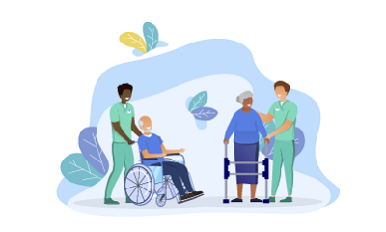

Component 2 – Health and Social Care services and values

Slide 6


Component 3 – Health and Wellbeing

Slide 7
Typical lesson content
Condition | Description/ symptoms | Impact on physical development | Impact on intellectual development | Impact on emotional development | Impact on social development
Sickle cell | Sickle shaped red blood cells. Blocked blood vessels, tiredness and pain | Delayed growth | Missed school when in pain | Negative self esteem | May not be able to socialise due to pain
Cystic fibrosis | Lung disease- mucus builds up in lungs and digestive system. Causes breathing and digestive problems. | Delayed growth. Fatigue. | Missed school due to fatigue or when being treated | Loss of independence | Fatigue may limit ability to socialise
Muscular dystrophy
Marfan syndrome
Huntington’s disease

Slide 8
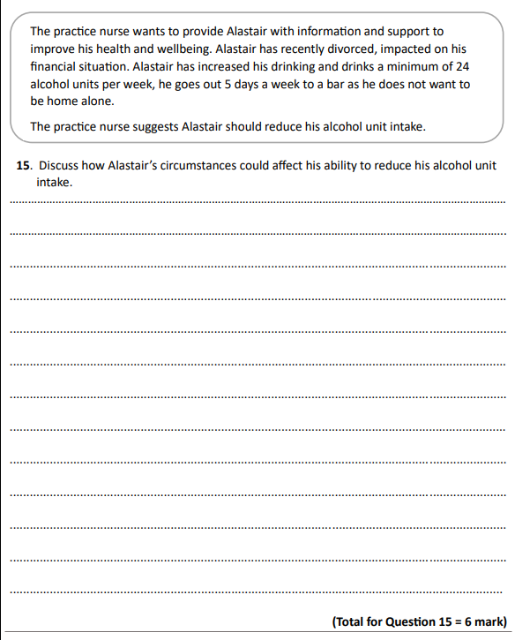
Typical Exam Question

Slide 9
BTEC Tech Awards Health and Social Care
If you have any further questions, please do get in touch:
btl@abbeyfield.wilts.sch.uk

