Slide 1



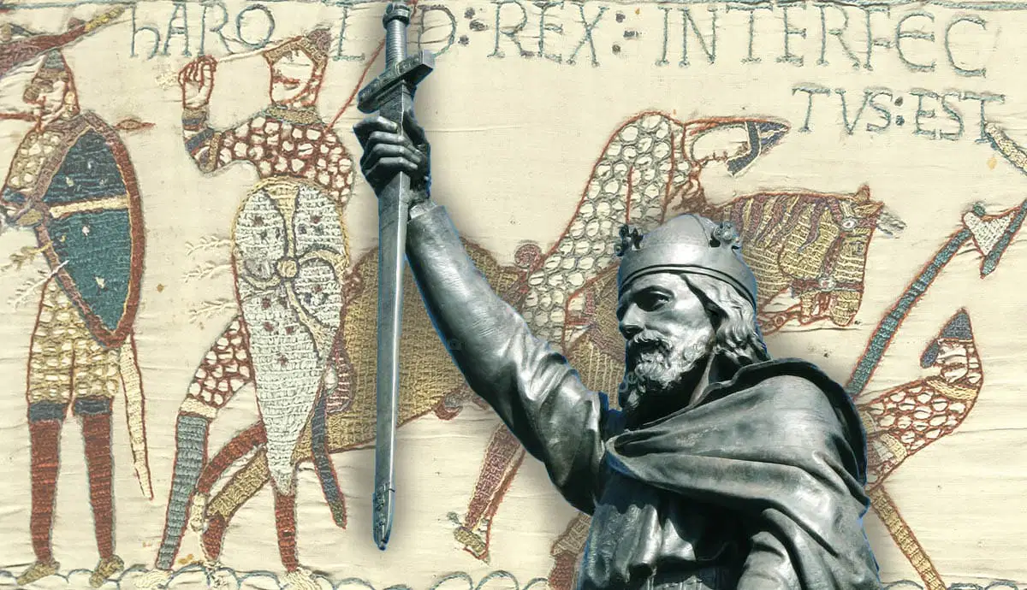
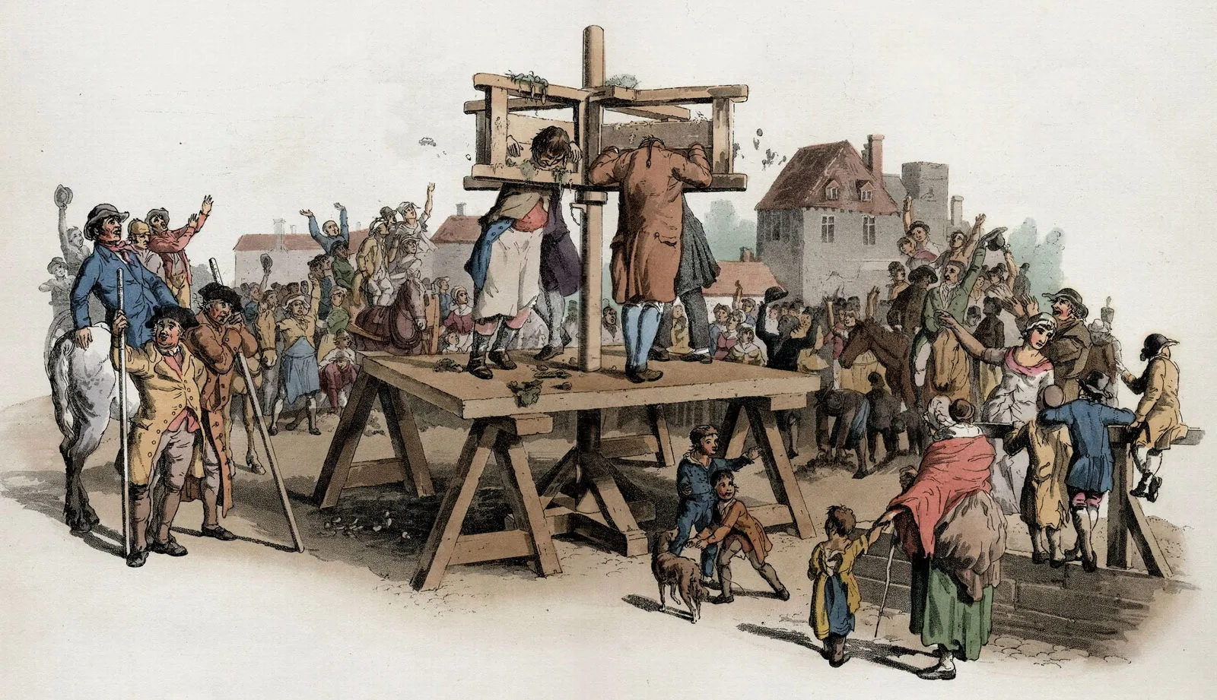
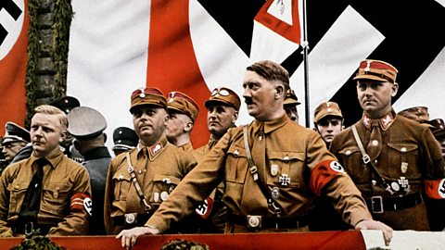
Welcome to GCSE History!
Please play the audio clip on the left first, then the one on the right.

Slide 2

Why study History?
History is continuously changing the world around us and historic events have helped to shape our society.
Studying GCSE History will help you to answer important questions such as…
Why did people vote for the Nazis?
How did the Norman invasion transform England?
How have attitudes to crime and punishment changed in England in the last thousand years?
Learning about the past will help you to greater understand the world today as well as the events in the future.
Apart from studying a wide range of events, you’ll learn a range of handy skills that will help you in future work. These include:
• excellent communication and writing skills
• how to construct an argument
• research and problem skills
• investigation and problem-solving skills
• analytical and interpretation skills.

Slide 3

History will open doors for you in the future.
Studying history can lead to some exciting career options, including:
• Journalism
• Law
• Business
• Politics
• Archaeology
• Marketing
• Teaching
In fact History teaches you such a range of transferable skills people go on to do such an extensive range of things.

Slide 4

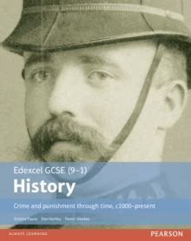
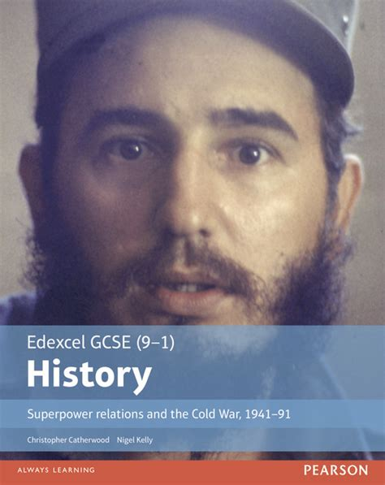
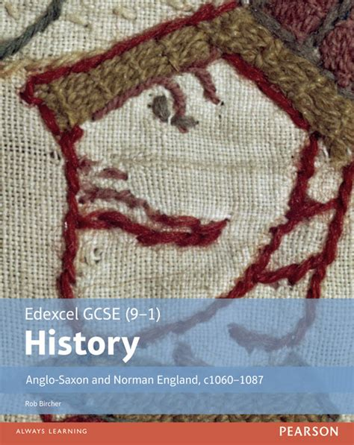
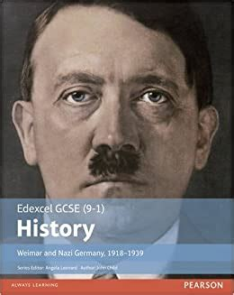
History GCSE
Through this course you will develop your knowledge and understanding of the history of Britain and the wider world. You will have to develop empathy and understanding of the actions and achievements of others. You also have to be prepared to put forward your case and argue it and you will have to use evidence to draw conclusions and make judgements. Finally you will also need to employ your critical skills to make sense of sources and interpretations of history and determine how useful these are to us and why there are different interpretations of history. You will study…
Unit 1: Crime and punishment in Britain from c1000 to the present and a case study of Whitechapel
30% written exam.
Unit 2: Period study and British depth study
The Cold War
The Anglo-Saxons and Normans
40% written exam
Unit 3: Weimar and Nazi Germany 1918-39.
30% written exam.

Slide 5
Further information / where to find us…
For further information please see either Mr Bryant or Mr Chilcott in school or email us at…
Mr Bryant: mjb@abbeyfield.wilts.sch.uk
Mr Chilcott: imc@abbeyfield.wilts.sch.uk

