Slide 1


GCSE Religion Philosophy and Ethics allows students to demonstrate their ability to:
Apply knowledge and understanding of two religions;
Understand the influence of religion on individuals, communities and societies;
Understand significant common and divergent views between and/or within religions and beliefs;
Construct well-informed and balanced arguments on matters concerned with religious beliefs and values.
Why do GCSE candidates choose Religious Studies?
“I like to learn about controversial issues.”
“I get to discuss moral issues and there are no wrong opinions.”
“I enjoy expressing my views and opinions and listen to the views of others.”

Slide 2

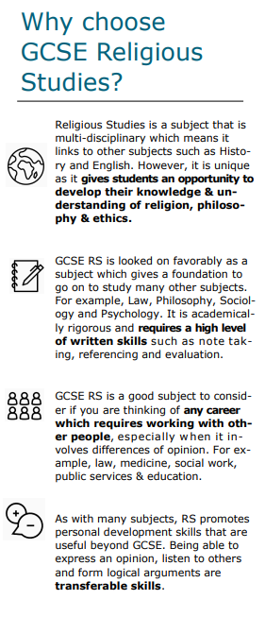
84% of the world's population class themselves as religious
You will focus on Buddhism and Christianity
You will also explore ethics and topics like abortion, euthanasia, the death penalty and much more

Slide 3
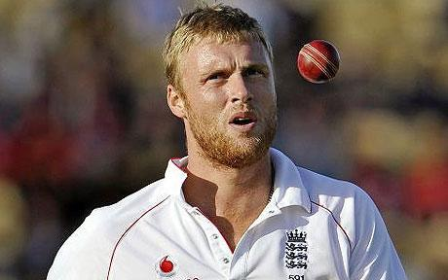
Why study RPE?
The academic discipline of Religious Studies provides important practice in essay writing, debate, comparison, analysis and evaluation, all of which are transferable to other subjects and further education.
Furthermore, immeasurable and essential life skills such as understanding, empathy, reflection and spiritual awareness are gained. Such skills are vital throughout life, particularly in this cosmopolitan age.
Freddie Flintoff: RS “… is probably the one thing I’ve used since leaving school. RE wasn’t just about Christianity, it was learning about the way in which different people live. Going to India and Pakistan and having an understanding of that helped me no end. I think I’ve taken a little bit from every religion I’ve encountered. Essentially, it’s all about being a better person and showing respect.”

Slide 4
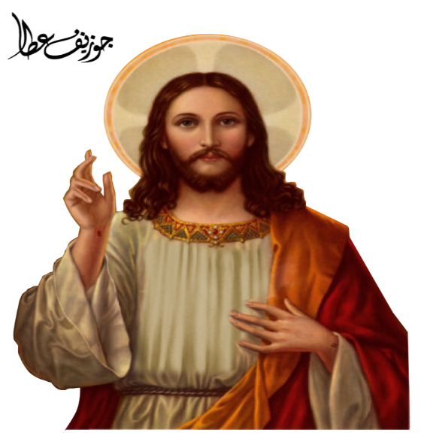

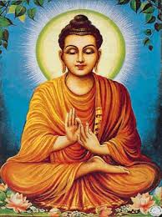
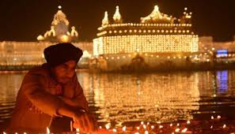
What do you study?
Ethics
Relationships and families
Religion and life
Peace and conflict
Crime and punishment
Philosophy
What do Christians, Buddhists believe?

Slide 5
How am I examined?
Two 1hr 45 papers.
Paper 1 – Beliefs and practises of Christianity and Buddhism
Paper 2 – Themes paper. Questions on the four themes you have studied, Families, Religion and life, Crime and punishment, Peace and conflict. You will discuss the different approaches Christianity and Buddhism have to these issues, as well as discussing your own opinions on these issues.

Slide 6
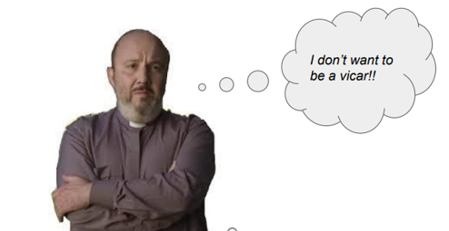
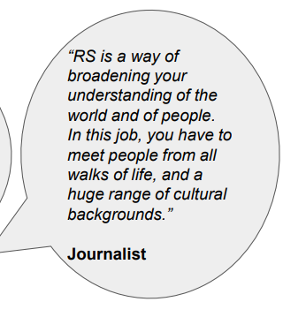
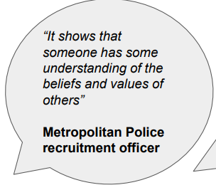
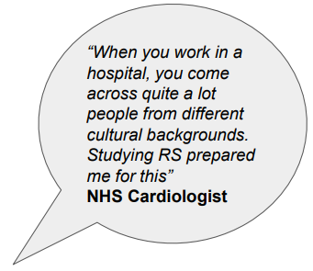
Where can RPE GCSE take me?
RPE acts as a gateway to lots of different careers. The transferable skills are needed in nearly all jobs and the ability to think and critically analyse is sought after by employers. Careers from Social work, Social care, Law, Armed Forces, Education, and Medicine are just some options.

Slide 7
